Slide 1
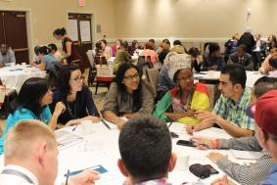
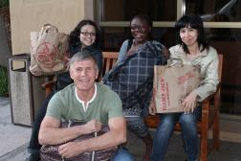
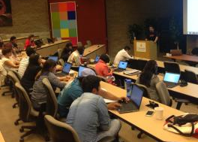
Teaching Excellence & Achievement Program
Notes:
FACILITATOR NOTES:
Introduction- Please read through the program name and explain to the audience that this presentation will give a brief overview of the TEA Fellowship, a professional development opportunity designed for full-time secondary school teachers. The objective of this presentation is to inform prospective TEA Fellows of the program implementers’ roles, provide detail on the various program components, eligibility requirements and selection criteria.

Slide 2
Participating Organizations and their Roles
Bureau of Educational and Cultural Affairs (ECA),
United States Department of State
Funds and oversees the program
U.S. Embassy and/or Fulbright Commission
Manages recruitment, conducts pre-departure orientation, and engages with alumni
IREX
Collaborates with ECA, US Embassies/Commissions and US Host Universities to implement the TEA program, manages alumni programming, conducts monitoring and evaluation, and provides general support
Notes:
Posts/ Commissions: Please insert your contact information in the slide above and note to potential applicants whom their point of contact should be throughout the recruitment and selection process. New to this year, Regional English Language Offices (RELOs) have been offered the opportunity to participate in the recruitment and selection process and support the program in identifying and selecting TEA candidates. RELOs are invited to nominate one English teacher per eligible country. If this is the case in your location, please insert that information as well.

Slide 3
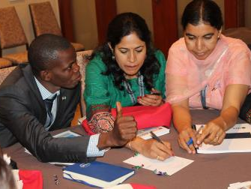
Teaching Excellence & Achievement Program
The Teaching Excellence and Achievement Program (TEA) will provide approximately 170 secondary school teachers from Europe and Eurasia, East Asia and the Pacific, the Near East, South and Central Asia, Sub-Saharan Africa, and the Western Hemisphere with unique opportunities to develop expertise in their subject areas, enhance their teaching skills, and increase their knowledge about the United States.
Notes:
Please highlight the intensity of the program. TEA participants will be involved in mandatory program activities a minimum of 35-40 hours per week. The intensity of the program can be demonstrated by the next slide, a sample weekly schedule.

Slide 4
TEA is an intensive non-credit, non-degree six-week professional development program at a U.S. university (January – March 2017 or September – November 2017). The TEA program includes:
Teaching Excellence & Achievement Program
A customized academic program in general pedagogy and discipline-specific education sessions;
A customized course in instructional technology;
Field experience at a U.S. secondary school;
Organized U.S. civic and cultural activities

Slide 5
Sample Weekly Schedule
Monday | Tuesday | Wednesday | Thursday | Friday | Saturday & Sunday
Morning- General Education Workshop | Morning- Field Experience | Morning- Field Experience | Morning- Field Experience | Morning- General Education Workshop | Individual work on lesson plans
Afternoon- Technology Workshop | Afternoon – Discipline specific workshops | Afternoon- Technology Workshop | Afternoon – Field Experience | Afternoon- Discipline-specific workshops | Trip to local museum and group lunch
Evening-Supplemental English Class | Evening - Dinner with Friendship Family | Evening- Group reflection; time to work on lesson plan development | Evening - PTA Meeting at U.S. Host School | Evening - Attend university hockey game | Personal time
Notes:
Please note that this slide is just a sample and that program schedules vary across Host Universities. The main point is that TEA Fellows will be engaged in program related activities at least 35-40 hours per week.

Slide 6
TEA Eligible Countries
Algeria Argentina Armenia Azerbaijan Bangladesh Belarus Bolivia Burkina Faso Cambodia Cameroon Chile Colombia Costa Rica Cote d’Ivoire Dominican Republic Ecuador | Egypt El Salvador Estonia Georgia Ghana Guatemala Haiti Honduras India Iraq Jordan Kazakhstan Kyrgyzstan Laos Latvia Lebanon | Lithuania Malawi Mali Moldova Mongolia Mozambique Nepal Nicaragua Niger Nigeria Panama Peru Russia Rwanda Senegal South Africa | Sri Lanka Sudan Tajikistan Thailand Tunisia Turkey Turkmenistan Ukraine Uruguay Uzbekistan Venezuela Vietnam West Bank/Gaza Zambia Zimbabwe
Notes:
One of the benefits of TEA is that participating teachers have the opportunity to not only collaborate with professionals from the U.S. education community but with teachers from across the globe as well. TEA Fellows are generally placed at Host Universities with at least one other teacher from their home country.

Slide 7
Program Overview - Academic Program
Customized Academic Program
General Pedagogical Seminars on topics such as:
Teaching strategies for home classroom environments
Student-centered teaching methodologies
Lesson plan and curriculum development
Teacher leadership
Notes:
The education course is the cornerstone of the program and is designed specifically for the TEA Fellows.

Slide 8
Program Overview - Academic Program
Academic Seminars:
Workshops that focus on teaching methodologies, curriculum development, lesson planning, teaching strategies, and intensive English language instruction for English, Math, Social Studies, Science, and Special Education teachers
Instructional Technology Seminars:
Technology for classroom use
General computer skills:
(Word, Excel, Power Point, etc.)
Notes:
Host Universities will also have education sessions designed specifically for the subject disciplines, allowing for smaller breakout sessions in which Fellows can focus on teaching trends and best practices related to their particular subject area.
TEA Fellows technology skills and experience will be assessed in advance of the program. Fellows may be placed in differentiated courses according to their technology skills and experience.

Slide 9
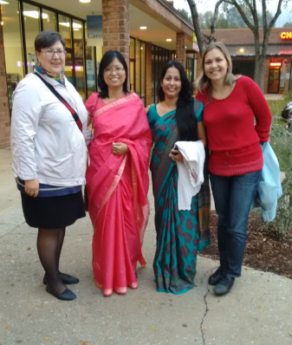
Program Overview - U.S. Secondary School Field Experience
During a two week field experience at a US secondary school, Fellows will:
Observe a variety of teaching methods
Co-teach with American teachers and work with students
Work closely with a U.S. teacher to develop lesson plans and pilot-testing lessons
Participate in extra curricular activities as available
Notes:
Fellows will be matched with a U.S. secondary school teacher in their same or similar teaching discipline. Fellows will have the opportunity to observe the U.S. classroom as well as team teach and lead lessons during the practicum. Practicum schedules vary across Host Universities.

Slide 10
Program Overview - Alumni Small Grants
After successfully completing TEA, alumni are eligible to apply for small grants.
This grant program is designed to complement the TEA goal of improving teaching in participating countries.
Notes:
TEA Alumni small grants are awarded through an open competition. In order to apply for an Alumni small grant, Fellows submit a proposal detailing their plan for the utilization of the funds. Fellows will receive thorough training on how to complete an Alumni small grant proposal during the program.

Slide 11
Program Overview - Alumni Small Grants
Examples of alumni small grants projects implemented by TEA alumni include:
A TEA alumnus of Kyrgyzstan was first awarded an alumni small grant to deliver workshops focusing on problem-solving, goal-setting, healthy living, and positive relationships to disabled students, peer leaders and their teachers in 2009. The project is currently being extended to 30 additional students and will focus on leadership through technology in collaboration with the Digital Youth Dialogue program which recently brought internet access to the region.

Slide 12
Program Overview - Alumni Small Grants
Examples of projects implemented by past program alumni include:
A TEA alumnus from Senegal successfully delivered a workshop on Teaching Scaffolding Writing Skills. Each of the 38 participants was trained in the content method as well as equipped with the skills necessary to deliver the workshop in their respective schools. The estimated indirect beneficiaries of the training is over 200 Senegalese teachers of English, and up to 8,000 students!

Slide 13
TEA Program Provisions
The TEA Program will provide the following:
J-1 visa support
A pre-departure orientation held in your home country
Travel (round-trip airfare from your home city to and within the U.S.) for participation in the program
A Welcome workshop in Washington, D.C.
A six-week university professional development program
Housing (generally shared with other Fellows)
Accident and sickness health coverage
A maintenance allowance for meals and incidentals during the program
A book/professional development allowance
An excess baggage/shipping allowance
Opportunity to participate in alumni programming

Slide 14
Eligibility Requirements for TEA
Applicants must:
Be current secondary-level, full-time teachers with five or more years of classroom experience in disciplines including English or English as a Foreign Language, mathematics, social studies, science, and special education teachers in those subject areas;
Be citizens of a TEA participating country
Be proficient in written and spoken English with a minimum paper-based TOEFL score of 450.
Commit to teaching after completion of the program; and
Submit a complete application.
* A limited number of Fellows with a TOEFL score between 425 and 450 will be accepted for the program into a special cohort with additional English language training provided.
Notes:
Please note the following categories of ineligibility:
Former participants of ILEP, TEA, Partners in Education (PiE) or the Fulbright Teacher Exchange Program are ineligible to apply.
Staff or families of staff at a U.S. Embassy or Fulbright Commission are not eligible to apply.

Slide 15
TEA Program Regulations
Fellows must return to their home countries for at least two years upon completion of the TEA program.
TEA does not allow for paid employment during the program.
No visa transfers or extensions will be given.
No visas for dependents (children, spouses)

Slide 16
TEA Selection Process
Selection is made through a merit-based open competition.
All applications are first reviewed for technical eligibility.
Top candidates are interviewed by an interview panel and take the TOEFL examination or other comparable examination.
Top nominees’ applications and TOEFL scores will be reviewed by IREX and ECA in Washington, D.C., and, barring any ineligibilities, the nominees will be confirmed as finalists.
*The Teaching Excellence and Achievement Program promotes diversity in the classroom and in learning. The TEA Program supports inclusion and strongly encourages teachers with disabilities to apply.
Notes:
Candidates may also be nominated as alternates, in which case they may be selected to be a finalist if a slot becomes available. Please note: if a finalist slot becomes available, alternates are drawn from the global pool of alternates (not simply from their country cohort of alternates) to be moved into a finalist position.

Slide 17
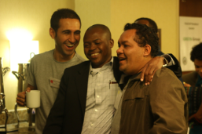
TEA Selection Criteria
Preparedness for an intensive U.S.-based training program;
Professional and educational experience and achievements;
Demonstrated commitment to teaching in secondary education;
Demonstrated leadership potential;
Potential for developing long-term linkages between U.S. and home country educational institutions and schools;

Slide 18
TEA Selection Criteria cont.
English language skills adequate to live, study, and function independently in the U.S.;
Willingness and capacity to work collaboratively with international peers to foster a positive learning community for professional development; and
Ability to express ideas clearly and effectively.
Applicants who have had few or no opportunities to travel to the
U.S. will be given priority.

Slide 19
Good Luck!
For further information or if you have questions,
you may contact
or
IREX at
teaglobal@irex.org

